Slide 1
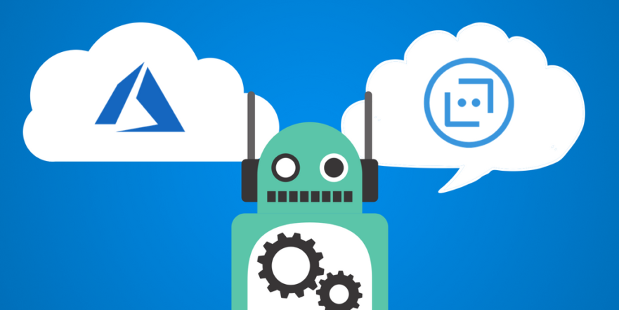
CHAT BOT

Slide 2
What Is a Chat Bot?
A chatbot is an application that simulates a human responding to the user. It’s a more natural way to interact with a system by using conversation.
Chatbots are being made to ease the pain that the industries are facing today. The purpose of chat bots is to support and scale business teams in their relations with customers. It could live in any major chat applications like Facebook Messenger, Slack, Telegram, Text Messages, etc.

Slide 3
Chatbots may sound like a futuristic notion, but according to Global Web Index statistics, it is said that 75% of internet users are adopting one or more messenger platforms. Although research shows us that each user makes use of an average of 24 apps a month, wherein 80% of the time would be in just 5 apps. Undoubtedly among them are Facebook Messenger, Snapchat, Whatsapp, WeChat etc. This means you can hardly shoot ahead with an app, but you still have high chances to integrate your chatbot with one of these platforms.
Wouldn’t it be great if someone could ease your pain by helping you out 24*7 making your work easier and less hectic. Chatbots can do just that!!

Slide 4
Benefits
Accessible anytime
Handling Capacity
Flexible attribute
Customer Satisfaction
Cost Effective
Faster On boarding
Work Automation
Alternate sales channel
Personal Assistant

Slide 5
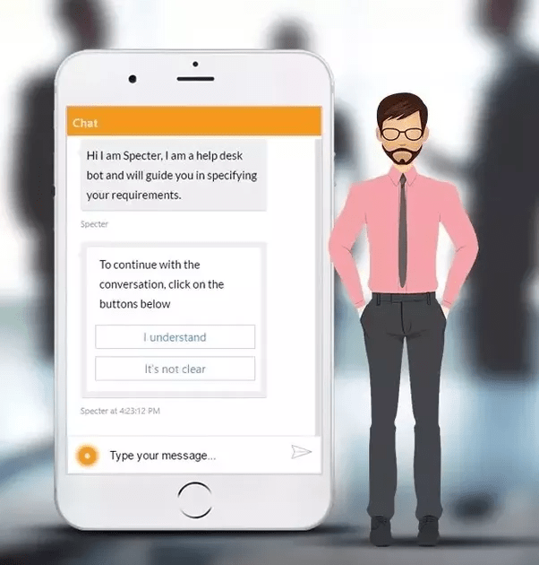

Slide 6
CHATBOTS AND SERVICE INDUSTRY - TOWARDS A BETTER CUSTOMER EXPERIENCE

Slide 7
As Artificial Intelligence race is on, major tech companies are already developing Chatbots to serve their customer in a better way. Many customer services oriented businesses believe that Artificial Intelligence tool could help their companies. But are not sure if their business is sophisticated enough to implement Chatbots in their systems.

Slide 8
Chatbots in
Restaurant and Retail Industries
Hospitality and Travel
Health Industry
E-Commerce
News Bots
Fashion Industry
Finance
Fitness Industry

Slide 9
Companies across a wide variety of industries are building these tools on popular messaging apps like Slack, Facebook Messenger, Kik, etc. as well as on their own apps and websites. Above are the majority of the industries where Chatbots have already entered, but that doesn’t mean that this is it. Chatbots and Service Industry together have a wide range of opportunities and small to big all size of companies can build their own bots to reduce their work and help their customers better.

Slide 10
How to Create One With Azure Bot Service
Luckily for us, Azure makes it really simple to create chatbots. In this post, I’ll show you two methods to use this service.

Slide 11
What is Azure Bot Service?
Azure Bot Service helps you to develop, deploy, and host a chatbot in a simple way.
One of the first things you need to do is create a chatbot. To ease this dreaded task, you can make use of the Microsoft Bot Framework (MBF). MBF supports C# and Node.js languages for production use, and you can also use Python and Java, which are already available in preview. MBF is an open source project, so you can find all of the concepts that you need to build a chatbot in MBF at GitHub. And if that’s not enough, you can also start quickly by using these samples.

Slide 12
When you use MBF, the chatbot logic is encapsulated and exposed by an API that will be consumed by an external channel like a mobile app. So when the chatbot is hosted in Azure Bot Service, it’s easier for your chatbot to be consumed across other channelslike Slack, Facebook, Skype, Twilio, and email, among others.
And if you want to debug and test your chatbot, you can make use of the MBF emulator. You can also easily deploy from Visual Studio to Azure, but my recommendation is to set up continuous deployment, which is also supported and easy to implement.

Slide 13
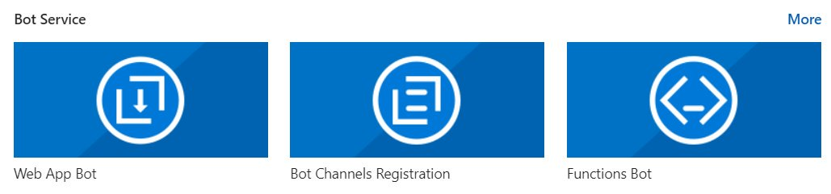
How much does it cost?
There are three categories for how much you’ll pay for this service, which also relates to how hosting works in Azure Bot Service. Here they are:

Slide 14
If you’re planning to host the chatbot on-premises or somewhere else for security and/or compliance reasons, you need to choose Bot Channels Registration. If you use public channels (such as Facebook or Slack) or Microsoft channels (like Skype or Cortana), you won’t be charged. But if you need to expose the API so that you can integrate it in a mobile app, you need to use the Direct Line channel. The Direct Line channel is free for the first 10,000 messages per month, then it costs $0.50 per additional 1,000 messages. Or you can decide to still not pay anything if you’ve reached the free tier—we’ll talk more about this later.

Slide 15
If, instead, you choose Web App Bot, that means that Azure will use App Service. Then, the same pricing as App Service will apply where you pay for the virtual machines you instantiate, plus the channel pricing that I mentioned before (if applicable).
Finally, the Functions Bot option creates a serverless chatbot by using Azure Functions. You only pay when the chatbot is used plus the channel pricing, if applicable.
So if you’re convinced that Azure Bot Service is the right option for you, let’s start.

Slide 16
Prerequisites
First things first, you’re going to need the following: A pizza to keep your motivation up—we’ll create a pizza bot today, so let’s set the proper mood.
An Azure account with a subscription. You need a credit card, but don’t worry—you’ll have free credits with your initial subscription. You can also get some free credits if you have an MSDN subscription, or if you sign up for the Dev Essentialsprogram. If you know more ways, let me know in the comments section.
The Microsoft Bot Emulator so that you can test the bot locally.

Slide 17
Method 1: Creating a web app bot using the portal
Open the Azure portal and click on the “Create a resource” link, then click in “AI + Machine Learning.” Finally, click on the “Web App Bot” link as you see in the following screen:

Slide 18
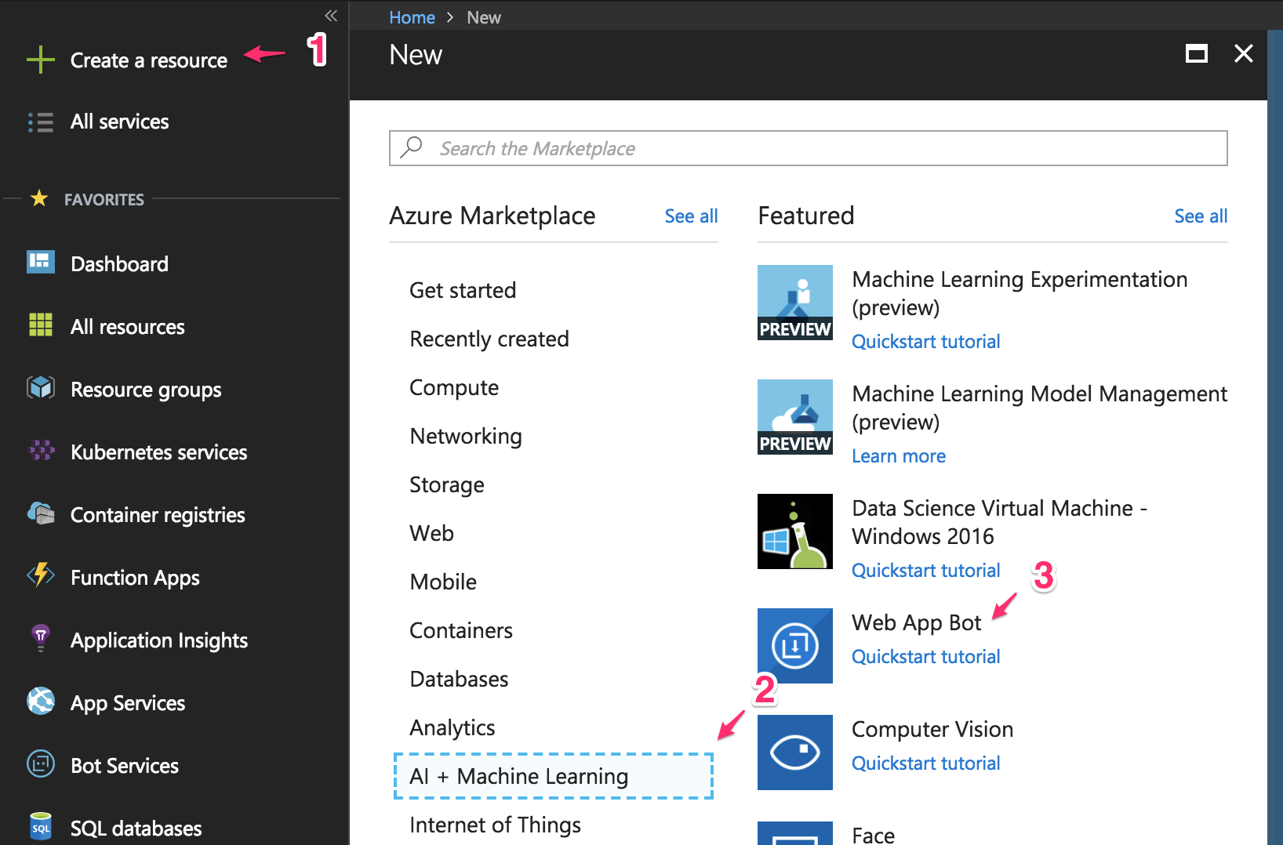

Slide 19
The following screen should appear to configure the web app bot:

Slide 20
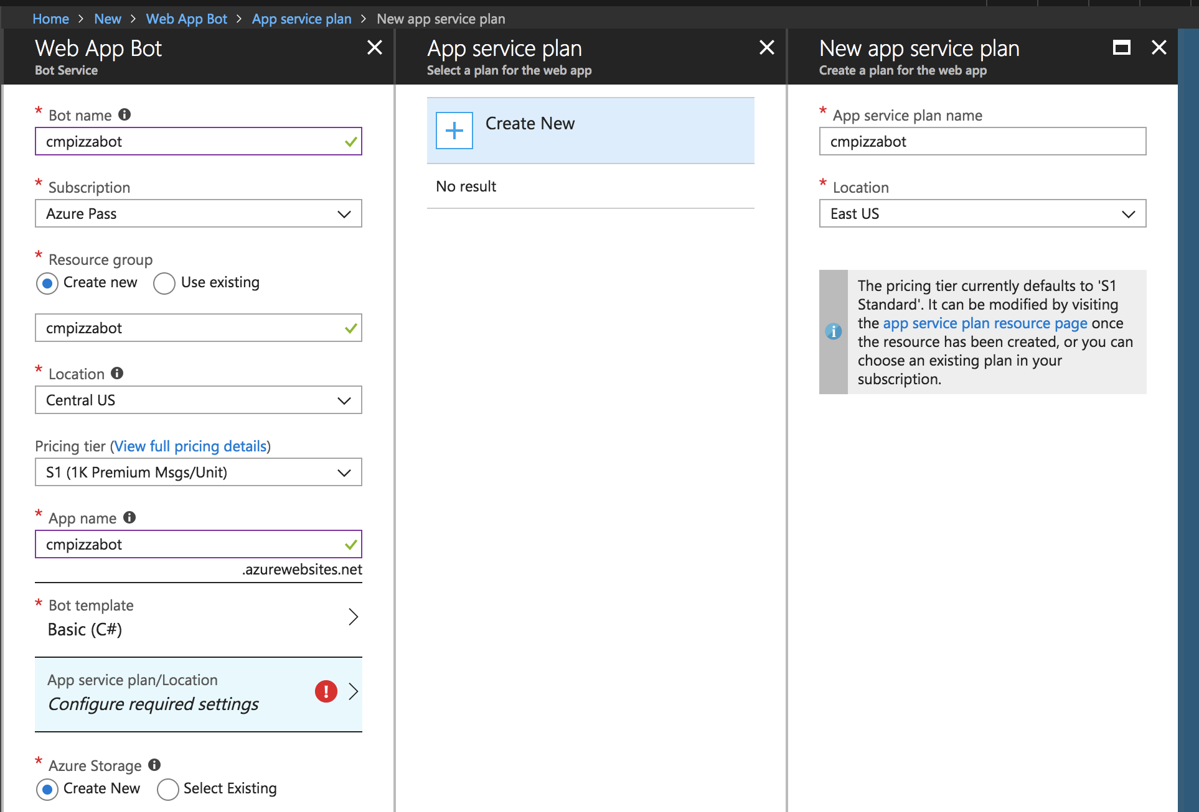

Slide 21
Your botname should be unique across Azure; you won’t be able to continue if the name is already taken. You can change the name later if you need to. Choose the subscription you want to use to pay for the service, or use some of your available credits. Create a resource group (or use an existing one) for the bot to easily manage all resources created in Azure.

Slide 22
Choose the nearest location for your customers. For example, if the bot will mainly be used by people in the U.S., choose a location in the U.S. You can’t change this option later so choose carefully. For the pricing tier option, you can choose F0 to not pay a penny because you’re just playing with the service, or because you’ll only be using public channels. We talked about this in the pricing section, but here’s a quick review:

Slide 23
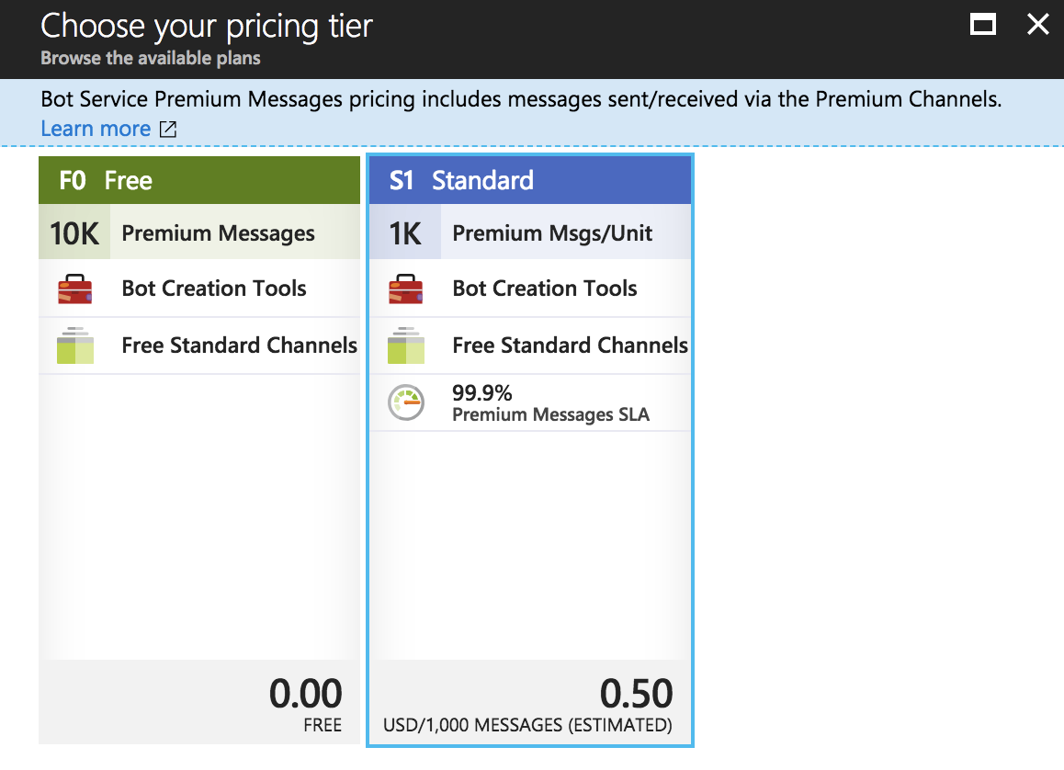

Slide 24
Your app name should also be unique across Azure because a subdomain will be created to access the web app bot. We’ll be deploying a pizza bot, so go ahead and leave the default selection for the bot template. But in case you’re curious, this is a starting point where you can select from a variety of basic templates to create a bot using the MBF we talked about earlier in this post. Here is a list of some templates:

Slide 25
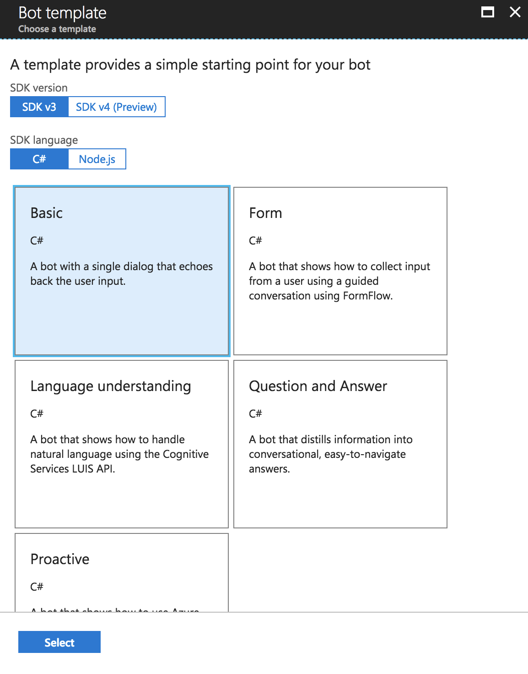

Slide 26
Now let’s choose the app service plan for the bot. You can use an existing plan or create a new one. If you decide to create a new one from here, you don’t have too many options. The default option will be an “S1 Standard” pricing tier, but you can later change this configuration to keep the defaults for now.
We’re almost done. Scroll down a little bit and you’ll see the following screen:

Slide 27
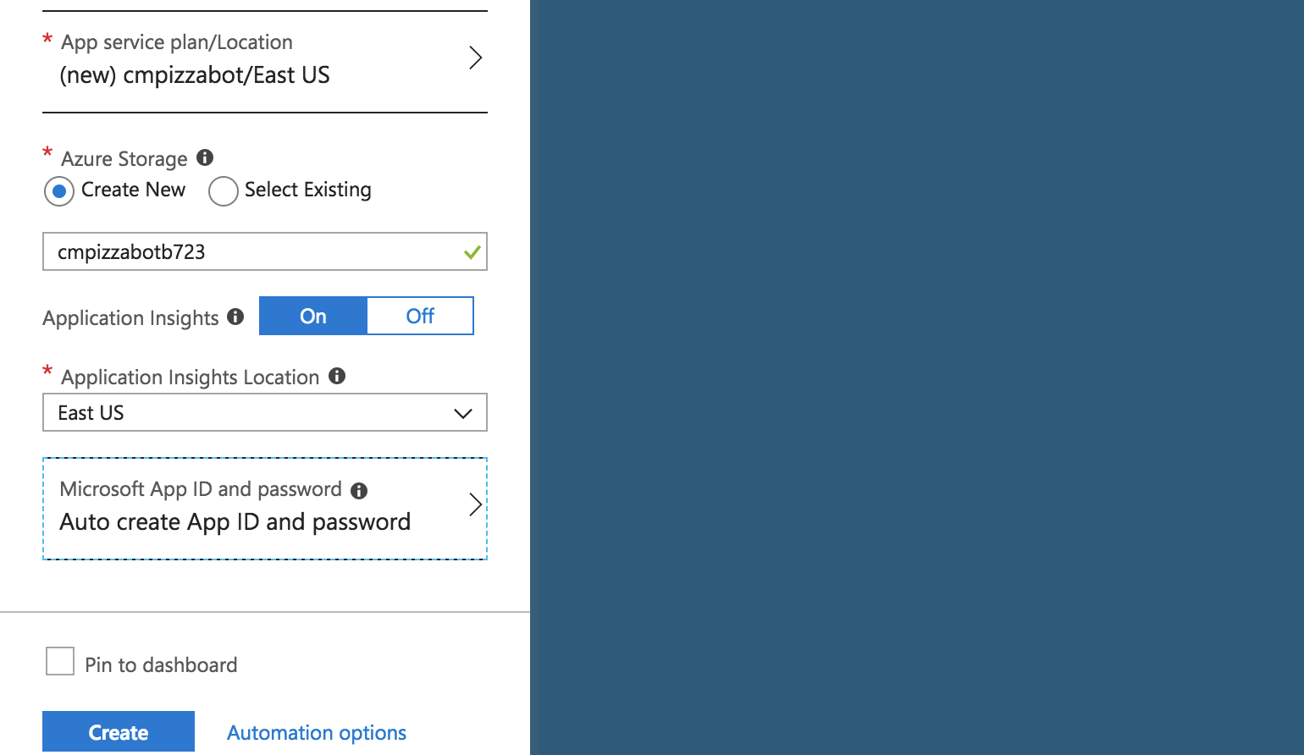

Slide 28
Create or select an existing Azure storage that will be used to store the state of the botusing blog storage. This is how the bot will remember things for your users and keep learning. Enable Application Insights and its location so that you can know the health of your web app bot from the very beginning.
Leave the default option for Microsoft App ID and password. This is outside the scope of the post, but basically, this is the part where you can configure an App ID that has the minimum permissions in Azure to work and a custom password. You can learn more about this in the docs.

Slide 29
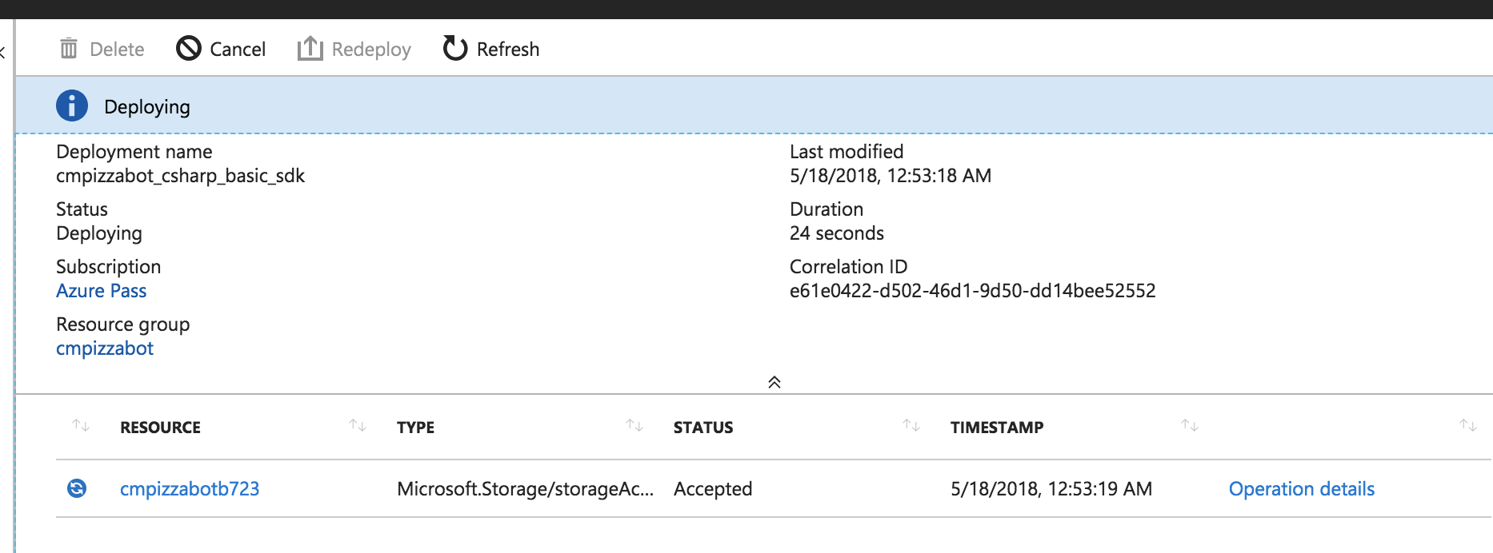
Click on the blue “Create” button. The following screen should appear now:

Slide 30
If you haven’t done so already, grab a slice of pizza and relax for a bit while Azure creates all of the resources for the web app bot.
Go to the resource groups and click on the web app bot you created to get a quick overview of the app:

Slide 31
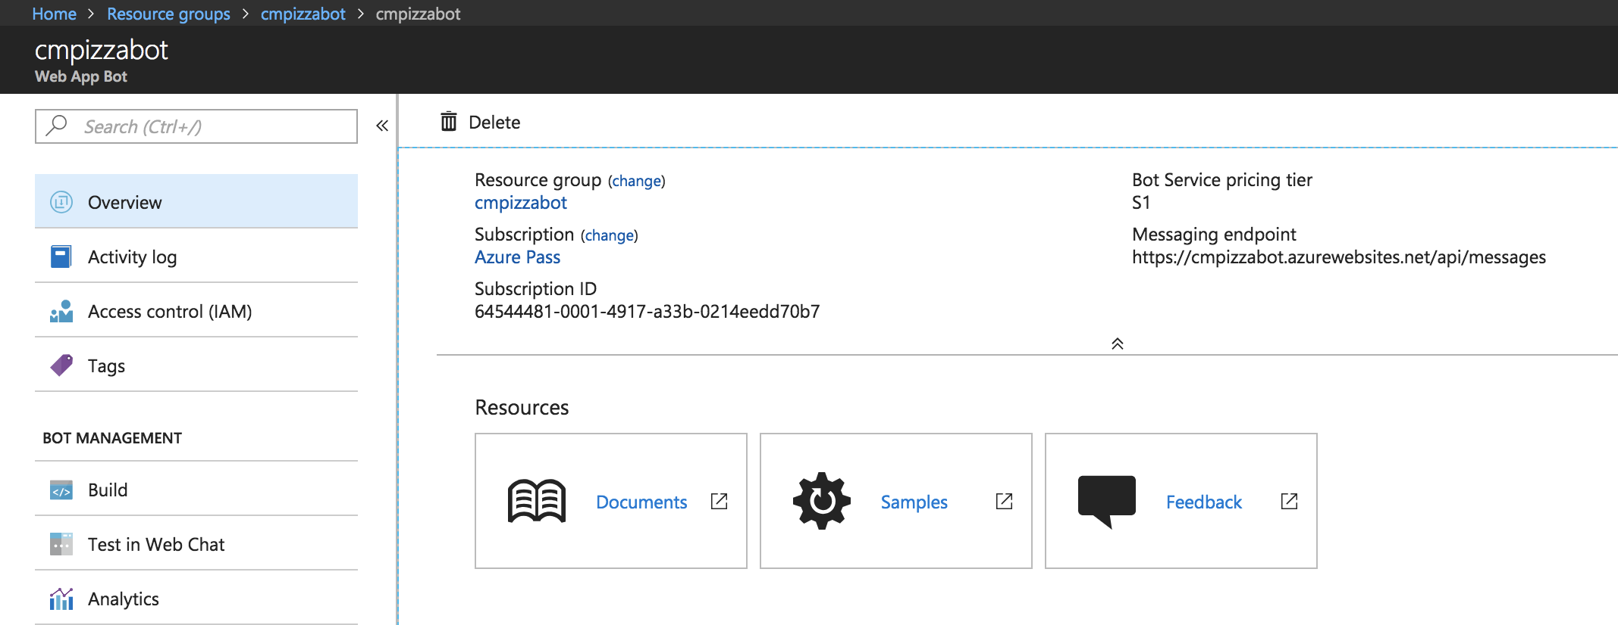

Slide 32
In this screen, you’ll be able to download the code, configure continuous deployment, or test the bot. Click on the “Test in Web Chat” link to interact with the bot. Because I chose the default option, the bot (basically a hello-world style app) doesn’t do anything other than reply back with what I just typed. Look:

Slide 33
